Slide 1

Student Grade Calculator Web Application
Nikhil Kumar

Slide 2
1. Introduction
The Student Grade Calculator is a web application built using Flask, a lightweight Python web framework. It allows users to input their marks and receive an automatically calculated grade based on predefined grading criteria.
2. Objectives
Develop a simple web-based grade calculator.
Implement backend logic using Python and Flask.
Create an interactive UI using HTML templates.
Allow users to enter marks and receive corresponding grades.

Slide 3
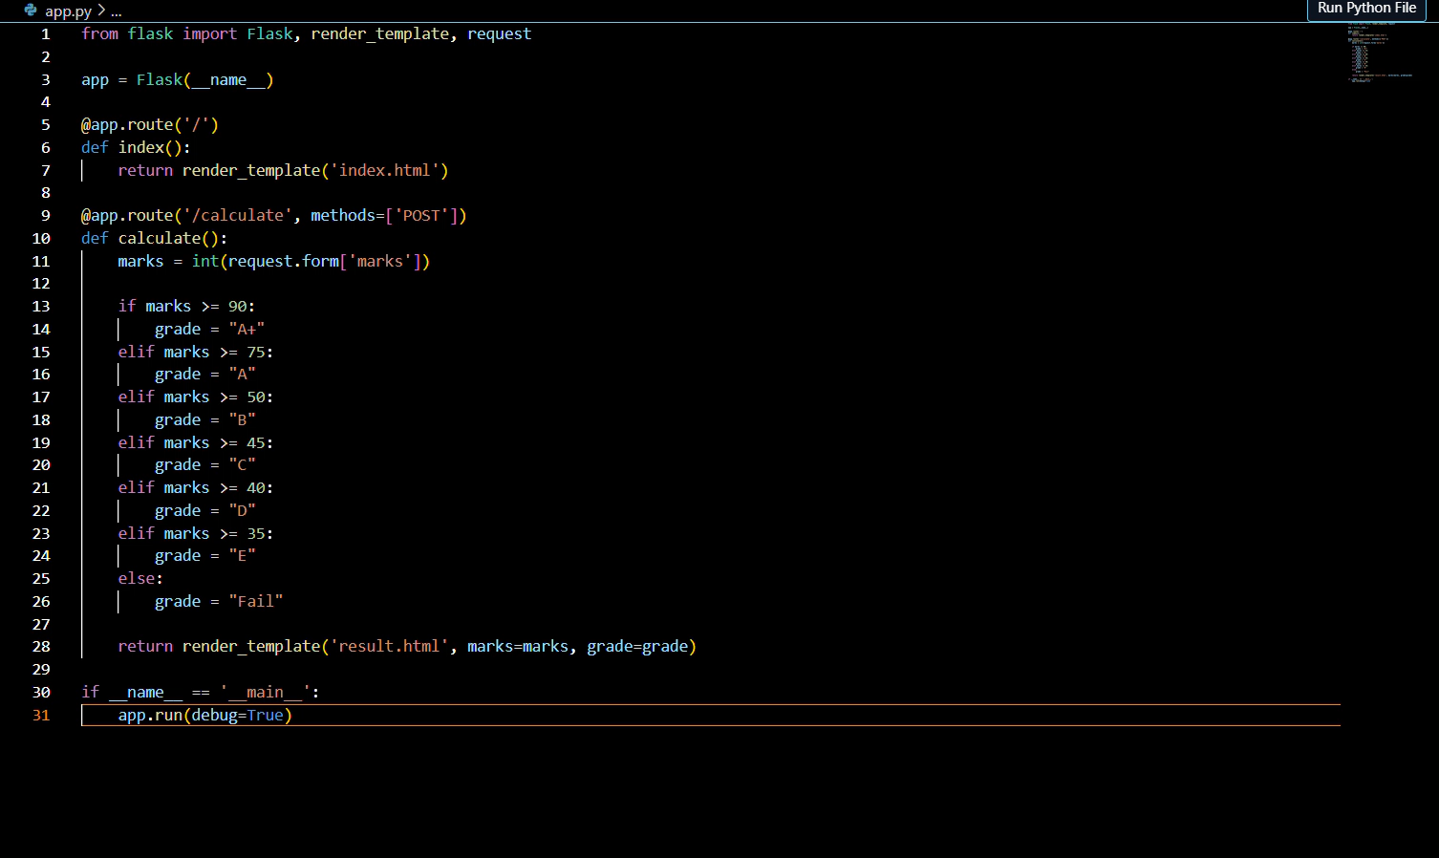
4. Project Structure
/student-grade-calculator
│── app.py # Main Flask application
│── templates/
│ │── index.html # Home page with input form
│ │── result.html # Result page displaying grades
│── static/
│ │── style.css # (Optional) Styles for UI
│── requirements.txt # Dependencies for Flask
│── README.md # Project documentation

Slide 4

5. Application Workflow
User accesses the homepage (/)
User enters marks and submits the form.
The backend (/calculate route) processes the input:
Determines the grade based on marks.
Returns the result to be displayed.
4. The result page (result.html) displays the grade

Slide 5
6. Code Overview
Backend (app.py)
The Flask app initializes routes:
/ → Renders the input form.
/calculate → Processes marks and returns the grade.
Uses conditional statements to determine grades.
Frontend (HTML & CSS)
index.html: Contains a form for users to enter marks.
result.html: Displays the grade after calculation.

Slide 6
7. Future Enhancements
Add JavaScript for real-time grade display.
Store user inputs in a database (SQLite, MySQL).
Enhance UI with Bootstrap for better design.
Implement user authentication for personalized grade history.

